Slide 1
UNIT -2
Model Of E-governance
Loknath Regmi
Assistant Professor, DHOD
Department of Electronics and Computer Engineering
IOE, Pulchowk Campus

Slide 2
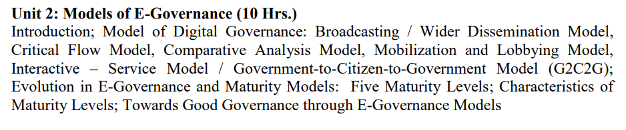

Slide 3
E-Governance Model
Good governance is an indeterminate term used in international development literature to describe how public institutions conduct public affairs and manage public resources

Slide 4
Model of E-governance
Digital Governance models keep on expanding and evolving as new applications of ICTs come to light and to deal with new issues in the area of governance.
There are no rigid or finite models of Digital Governance. In fact developing countries are experimenting on their own to find which models will works for them and will best serve their needs.

Slide 5
Model of E-governance
Based on primary experimentation and secondary research, a few generic models which have emerged and are being practiced have been identified.
Broadcasting / Wider-Dissemination Model
Critical Flow Model
Comparative Analysis Model
E-Advocacy/ Lobbying and Pressure Group Model
Interactive- Service Model

Slide 6
Broadcasting / Wider-Dissemination Model
Broadcasting model is based on mass dissemination of governance-related information which is already available in the public domain into the wider public domain using ICTs.
It allows citizens to form an opinion of the government and its administration based on services delivered to them - whether the government services were available to them, and the quality of service received.

Slide 7
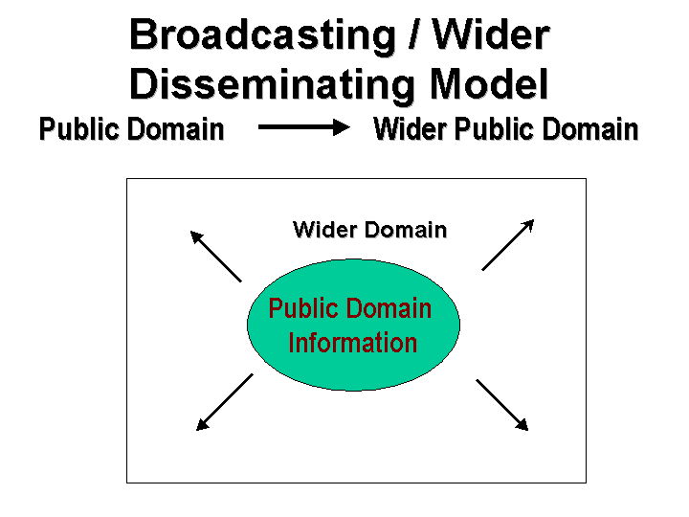
Applications
Putting governmental laws and legislations online
Making available the names, contact addresses, emails, mobile numbers of local/ regional/ national government officials online.
Make available public interested information such as governmental plans, budgets, expenditures, and performance reports online.
Putting key judicial decisions which are of value to general citizens and create a precedence for future actions online. viz. key environmental decisions, state vs. citizen decisions etc.

Slide 8
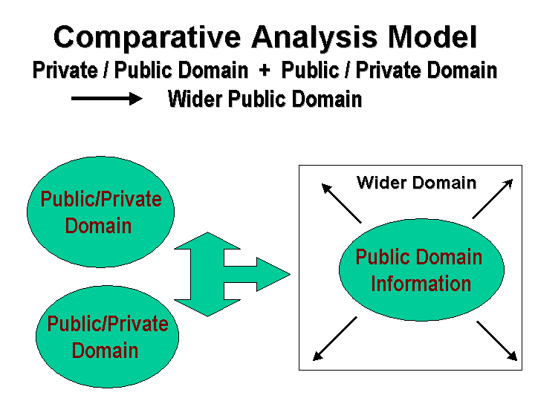
Comparative Analysis model

Slide 9
Comparative Analysis model
Comparative Analysis Model is one of the least-used but a high potential e-governance model for developing countries.
The model can be used to empower people by comparing cases of bad governance with those of good governance and identifying specific aspects of bad governance, the reasons and people behind them, and how the situation can be improved.

Slide 10
Comparative Analysis model
Essentially, the model continuously assimilates “best practices” in different areas of governance and uses them as benchmark to evaluate other governance practices.
It then uses the result to advocate positive changes or to influence 'public' opinion on existing governance practices.
The comparison could be made over a time scale to get a snapshot of the past and the present situation or could be used to compare the effectiveness of an intervention by comparing two similar situations.

Slide 11
Comparative Analysis model
Applications
To learn from past policies and actions and derive learning lessons for future policy-making.
To evaluate the effectiveness of the current policies and identify key learning's in terms of strengths and flaws in the policies.
To effectively establish conditions of Precedence, especially in the case of Judicial or legal decision-making (example for resolving patent-related disputes, public goods ownership rights), and use it to influence/ advocate future decision-making.
To enable informed decision-making at all levels by enhancing the background knowledge and also providing a rationale for action.
To evaluate the performance and track-record of a particular decision-maker/ decision-making body.

Slide 12
Comparative Analysis Model: Discussions
Pros
Developing countries could very effectively use this comparative model as ICT opens their access to the global and local knowledge products at a relatively low -cost.
The model is very much based on the existing sets of information but requires the ability to analyse and bring out strong arguments which could then be used to catalyze existing efforts towards self governance.
There is a vast scope of application of this model for judicial advocacy as landmark/key judgments of the past could be used as precedence for influencing future decision- making. Further, watch-guard organizations and monitor-groups can use this model to continuously track the governance past record and performance and compare with different information sets.
Cons
The model however becomes ineffective in absence of a strong civil society interest and public memory which is essential to force decision-makers to improve existing governance practices.

Slide 13
Critical Flow Model
Basic Principles
The model is based on broadcasting information of 'critical' value (which by its very nature will not be disclosed by those involved with bad governance practices) to targeted audience using ICTs and other tools.
Targeted audience may include media, affected parties, opposition parties, judicial bench, independent investigators or the general public.
The strength of this model is that the concept of 'distance' and 'time' becomes redundant when information is hosted on a digital network.
Once available on the digital network, the information could be used advantageously- by instantly transferring the critical information to its user group located anywhere or by making it freely available in the wider public domain.

Slide 14
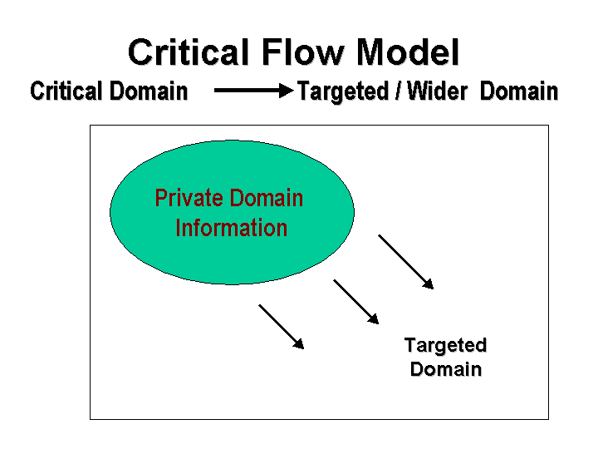
Uses of Critical flow model
Understanding the "critical and use value" of a particular information set.
How or from where this information could be obtained
How could the information be used strategically?
Who are the best target group for such information- the users for whom the availability of this information will make a huge difference?

Slide 15
Critical Flow Model
Applications
Making available corruption related data about a particular Ministry / Division/ Officials online to its electoral constituency or to the concerned regulatory body.
Making available Research studies, Enquiry reports, Impact studies commissioned by the Government or Independent commissions to the affected parties.
Making Human Rights Violations cases violations freely available to Judiciary, NGOs and concerned citizens.
Making available information that is usually suppressed, for instance, Environmental Information on radioactivity spills, effluents discharge, information on green ratings of the company to concerned community.

Slide 16
Projects Based on this model
Global:
Transparency International -Daily Corruption News. The daily corruption news has been coming out since May 2000.
Global:
Wikileaks www.wikileaks.org WikiLeaks is a not-for-profit media organisation. It brings important news and information to the public. - See more at: http://www.digitalgovernance.org/index.php/models/critical-flow#sthash.xkK2aRt6.dpuf
Bangladesh :
Human Rights Portal http://www.banglarights.net
The portal will actively promote human rights reforms both within Bangladesh and across geographical and political boundaries, and will support women, children, and marginalized communities in resisting social oppression.
India: Central Vigilance Committee http://cvc.nic.in
The website provides free-access information to citizens about government officials who have been indicted on judicial charges relating to corruption and have been advised penalty.
China: Human Rights in China http://iso.hrichina.org/iso/
Human Rights in China (HRIC) is an international non-governmental organization founded by Chinese scientists and scholars in March 1989.

Slide 17
E-Advocacy Model/Mobilization model
E-Advocacy / Mobilization and Lobbying Model is one of the most frequently used Digital Governance model and has often come to the aid of the global civil society to impact on global decision-making processes.
The strength of this model is in its diversity of the virtual community, and the ideas, expertise and resources accumulated through this virtual form of networking.
The model is able to mobilize and leverage human resources and information beyond geographical, institutional and bureaucratic barriers, and use it for concerted action.

Slide 18
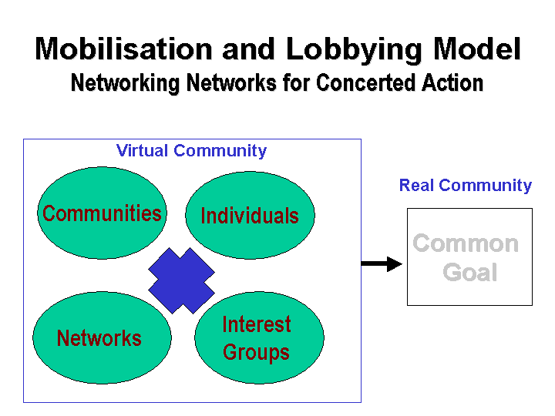

Slide 19
E-Advocacy Model
Applications
Fostering public debates on issue of larger concerns, namely on the themes of upcoming conferences, treaties etc.
Formation of pressure groups on key issues to force decision-makers to take their concerns into cognizance.
Making available opinions of a suppressed groups who are not involved in the decision-making process into wider public domain.
Catalyzing wider participation in decision-making processes.
Building up global expertise on a particular theme in absence of localized information to aid decision-making.

Slide 20
Project based on This model
Global:
Greenpeace Cyber-activist Community an effort towards creation of virtual communities to mobilize global support against some of the disputable environmental policies/ actions of the Government.
http://cybercentre.greenpeace.org/t/s/community_articles
Global:
Drop the Debt Campaign - the campaign spreads awareness of their activities through emails and mobilizes support of concerned individuals.
http://www.jubileeusa.org/
India: PRS Legislative Research
Tracks parliamentary bills which have been introduced and are coming up for discussions

Slide 21
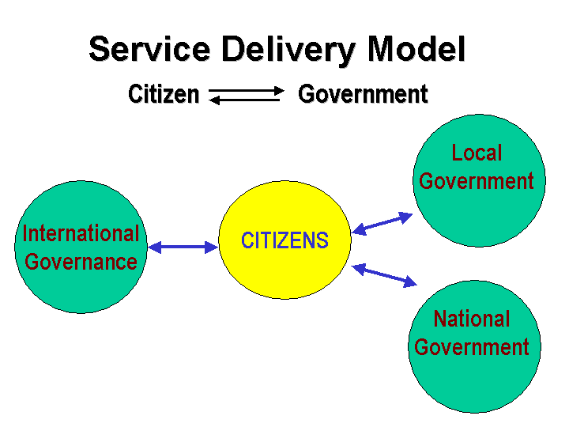
Interactive Service Model/G2C2G

Slide 22
Interactive Service Model
Interactive-Service model is a consolidation of the other digital governance models and opens up possibilities for one-to-one and self-serviced participation of individuals in governance processes.
Under this model, the various services offered by the Government become directly available to its citizens in an interactive manner.
It does so by opening up an interactive Government to Consumer to Government (G2C2G) channel in various aspects of governance, such as election of government officials (e-ballots); decision to make on specific issues (eg: health plans), delivery of individualized government services, gauging public mood and opinions, targeting specific communities for specific governance advice or services, bringing mass awareness.

Slide 23
Interactive Service Model
Applications
To establish an interactive communication channels with key policy-makers and members of planning commissions.
To conduct electronic ballots for the election of government officials and other office bearers.
To conduct public debates / opinion polls on issues of wider concern before formulation of policies and legislative frameworks.
Filling of grievances, feedback and reports by citizens with the concerned governmental body.
Establishing decentralized forms of governance.
Performing governance functions online such as revenue collection, filing of taxes, governmental procurement, payment transfer etc.

Slide 24
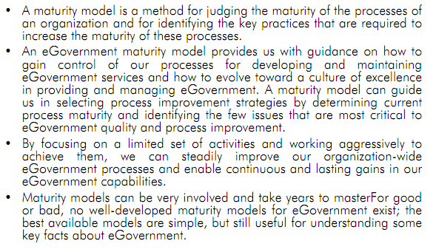
Maturity Model of E- governance

Slide 25
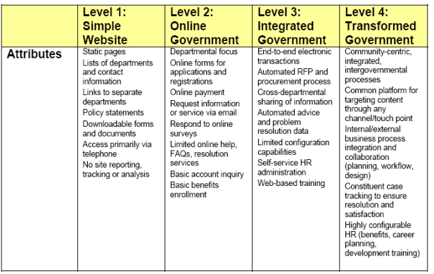
Maturity Model

Slide 26
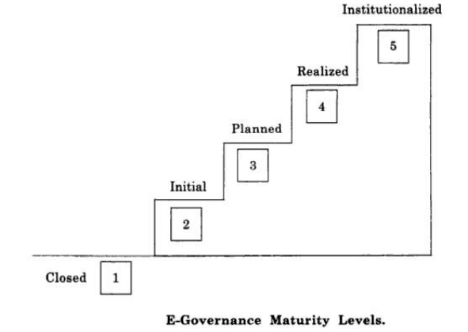
Maturity Level

Slide 27
Five maturity model
The E-Governance maturity model (EMM) is based on the fact that
speed ,openness and ubiquity are some of the major capabilities of ICT, which can be leveraged for generating transparency , responsiveness and accountability in the system ,
empowering the common man by providing faster access to right information at the right time ,
It is also based on a service oriented approach , where public administration is seen as a services to the internal and external users is emphasized as a key performance indicator of the government department. The internal users of an organization are its employees and the external users are the citizens, businesses, and other government and non –government bodies that the organization needs to satisfy in its e-governance Endeavour.

Slide 28
Level 1: Closed
This is the stage when an organization does not use ICT as a facilitator for good governance and has no plans to do so in the near future.
This situation may arise due to lack of exposure to ICTS and associated benefits that again may depend upon a number of reasons ,remoteness from the main stream in terms of locations is primary and lack of resources and strategic thinking
As a result the organization is closed in terms of being connected and sharing of information in context of e-governance.
However, even in this condition the organization may be efficiently functioning.

Slide 29
Level2: Initial
This level corresponds to the stage when an organization has initiated the automation of its processes but on a ad-hoc basis.
No organized efforts are made to undertake the governance initiatives.
May of such efforts are abandoned due to lack of proper direction.

Slide 30
Level 3: planned
The e-governance initiative at this level is under taken with a systematic approach.
The organization has a clearly defined vision, objectives and goals for e- governance.
A need assessment study is conducted to prioritize areas of implementation and gauge the extent of e- readiness.
Taking input from the need assessment study, extensive planning has been carried out indicating policies, strategies , various activities , stake holder , roles and responsibilities and resources required in terms of time , money and man power to undertake the e- governance exercise.

Slide 31
Level4:realized
This level corresponds to the stage when the organization actually the complete e-governance plan.
Consequently, an integrated system is established where all the internal processes of the organization are computerized and there is a seamless information exchange among all concerned entities.
The organization starts delivering services to it’s external as well as internal customers /users in an effective manner.
Complete realization of the plan, in a single instance, would entail enormous amount of resources in terms of time, money and manpower which may necessitate adopting a phased approaches for operationalizing the e-governance services.

Slide 32
Level4:realized (Contd..)
1. Retraspected: At this level, the organization has retrospectively studied its business processes in view of its vision, over all e-governance objectives, the service oriented approach and changes, if required, in the processes are initiated as a constant evolutionary process.
2. E-ready: In this stage, e-readiness essentials which are the buildings blocks for e- governance are ensured by the organization.
3. Partially open: At this stage some of the e-governance services are operationalized resulting in a partial information exchange among the entities both within and outside the organizations.
4. Open: This sub level of realized state implies complete deployment of e-governance services that ensures an integrated system that is open to information exchange.

Slide 33
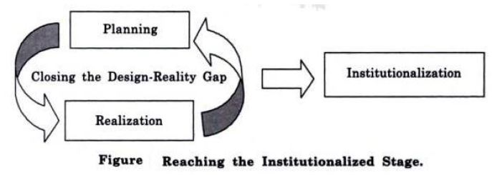
Level5:Institutionalized
At this level, the organization sustain the realized state over a period of time so that e-governance becomes part of its work culture. The e-governance services are effectively utilized and accepted by the users. Several iteration between planned and realized state lead to institutionalized, when e-governance becomes a way of life.

Slide 34
Level5:Institutionalized (contd..)
E-readiness essentials:
Presence of strategic thinking, leadership and commitment among top level decision makers.
Institutional infrastructure: These should be institutions responsible for creating e-governance awareness among stakeholders and users and coordinate the e-governance exercise.
ICT infrastructure: A sound computing and communication infrastructure is an essential requirement for effective operationalized of e-governance services.
Human capabilities: It is important to build human capabilities in terms of necessary knowledge and skills to indicate, implement and sustain e-governance initiatives .It is equally important to generate right attitude that is receptive to ICT based administration and ICT based delivery of services.

Slide 35
Characteristics of maturity levels
Level1: Closed
organizations are closed to e- governance.
No plans or version is available.
continue with fully manual and conventional operations.

Slide 36
Characteristics of maturity levels (Contd..)
Level2:Initial:
Organizations lack strategic thinking and direction for e-governance at top level.
There are unorganized and isolated effects of automation in some areas.
Automation efforts are a result of individual’s initiatives.

Slide 37
Characteristics of maturity levels (Contd..)
Level3: planned:
E-governance is a part of organization’s agenda.
Strategic thinking and leadership guide the e-governance initiatives.
Clear understanding of e- governance needs as projected by the external and internal customers.
Extensive plan is prepared for implementing e-governance, addressing all key focus areas and other related issues.

Slide 38
Characteristics of maturity levels (Contd..)
Level 4:Realized
Retrospected:
Businesses processed are attuned with the vision and overall e-governance objectives. There is aware about e-governance among all concerned, the stakeholders as well as the customers.
E-ready:
The organization has a sound infrastructure (technology, institutional, legal and human) in place, for implementing e-governance.
The customers are oriented and motivated to use e-governance services.

Slide 39
Characteristics of maturity levels (Contd..)
Level4: Realized
Partially open:
Some of the e- governance services are deployed, leading to partial information exchange among the entities.
Partially open organizations sometimes focus only on their internal or backend processes, allowing an information exchange confines within the organization. In such cases,G2E interface is visible, whereas G2C,G2G and G2B interfaces are not established.
Another case of partial deployment of e-governance services results in a conspicuous G2C interface with no emphasis on building G2E, G2B interfaces.

Slide 40
Characteristics of maturity levels (Contd..)
Level4: Realized
Open :
The organization has an integrated system reflective of smooth exchange within and outside the organization i.e. G2E, G2C, G2G, G2B interface are well established over a sound foundation of e- governance building blocks.
Organization focuses on satisfying the uses of e-governance services.
The internal and external customers of the organization start utilizing the e-governance services and become depend on them.

Slide 41
Characteristics of maturity levels (Contd..)
Level5:institutionalized:
The e-governance system of the organization is driven by a well-established knowledge management system that generates an ability in the organization to evolve with time in view of new requirement.
E-governance becomes an effortless exercise for the organization and it becomes a way of life for stakeholder and customer. The organization at this level is completely paperless.
Key focus areas: Key focus areas (KFA) indicate the areas that need to be focused by an organization and are a set of related activities when performed collectively, help achieving a particular level of maturity.

Slide 42
Thank You!!!!

